Slide 1
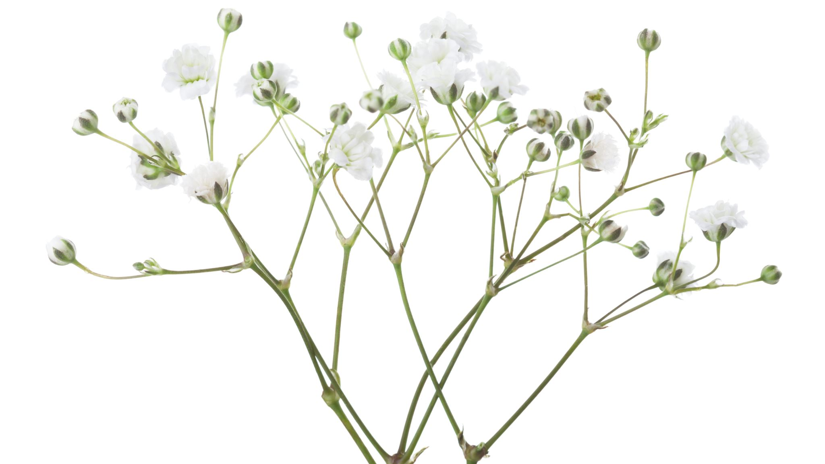
Christopher Han’s Project Presentation

Slide 2
Overview
My method:
Enumeration with Branch-and-Bound
Why:
No recursion or recursion stacks
Intuitive (for me anyway)
Only need to store incumbent solution, an array of relaxation solutions and an enumeration array

Slide 3
Enumeration with Base-3 Numbers
Suppose we represent all possible solutions as base-3 numbers.
Each position of the base-3 counter is associated with a gene.
This counter can be represented in-program as an array of values.
Index (i) | i = 3 | i = 2 | i = 1
Base-10 value | x₃ × 3² | x₂ × 3¹ | x₁ × 3⁰
gene | gene 3 | gene 2 | gene 1

Slide 4
Enumeration with Base-3 Numbers
Each base-3 digit represents a discretized number:
“0” represents 0 (neutral)
“1” represents 1 (up)
“2” represents -1 (down)
An example of a base-3 counter being incremented:
000
001
002
010
011
012
Etc.

Slide 5
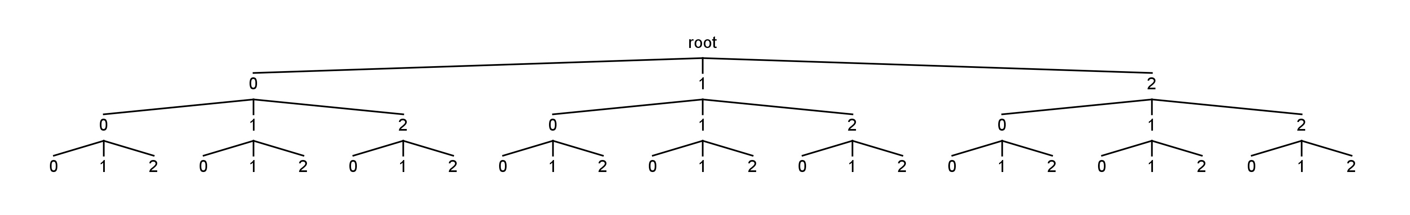
Ternary Trees
Represent the solution space as a trinary tree
Each level of the tree represents a gene position

Slide 6
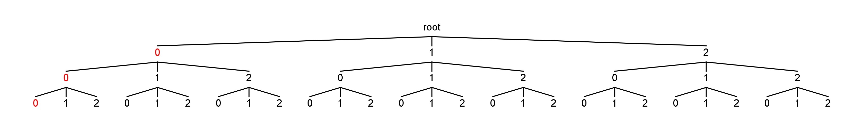
Reading Forward (right-to-left)
000

Slide 7
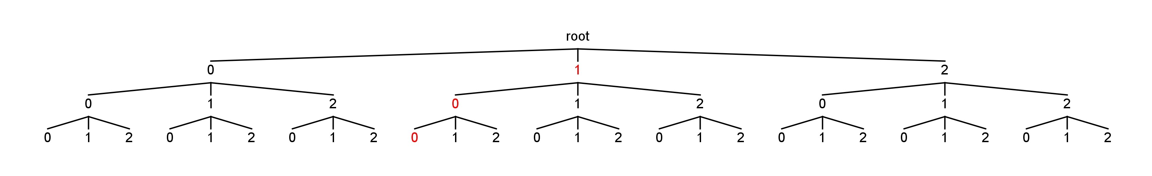
Reading Forward (right-to-left)
001

Slide 8
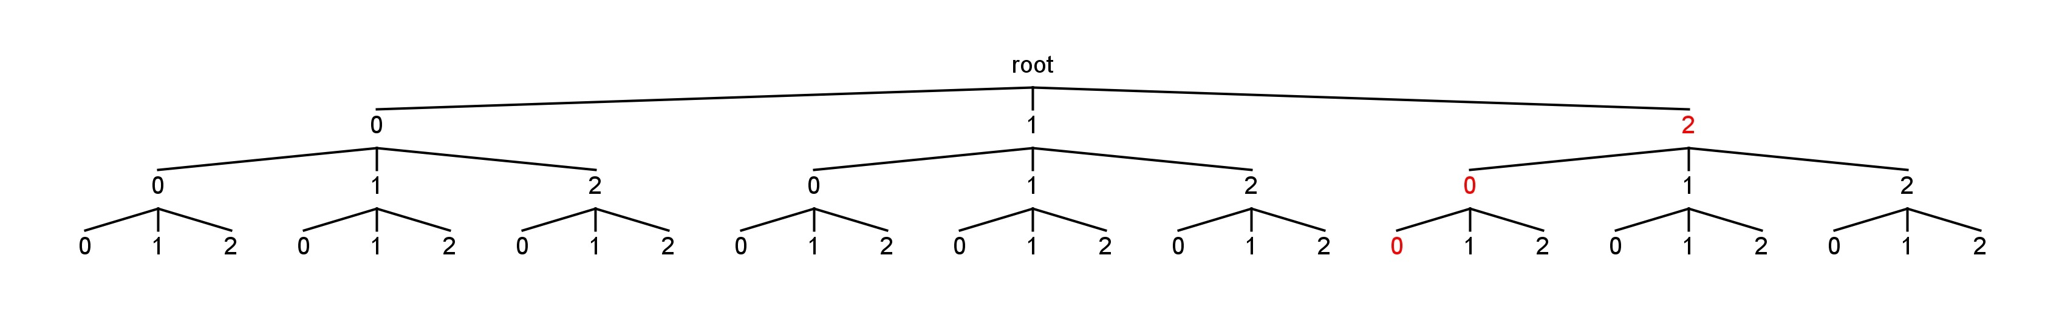
Reading Forward (right-to-left)
002

Slide 9
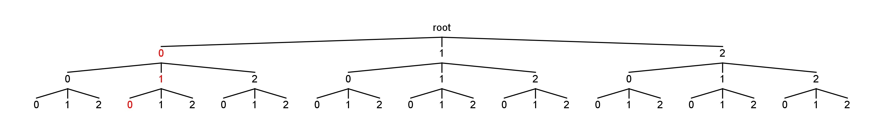
Reading Forward (right-to-left)
010

Slide 10
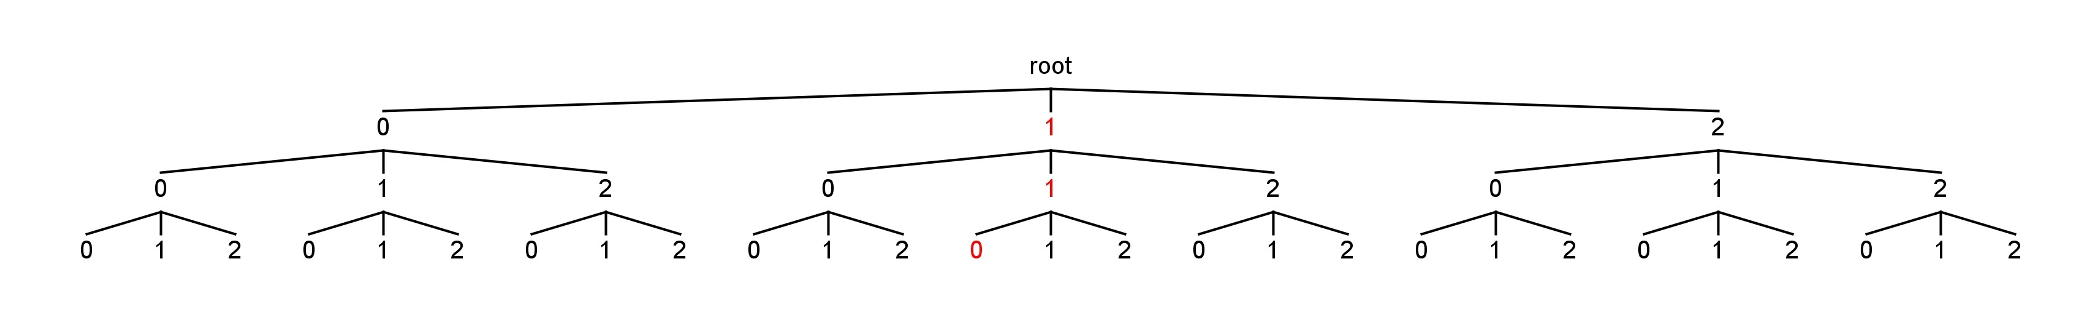
Reading Forward (right-to-left)
011

Slide 11
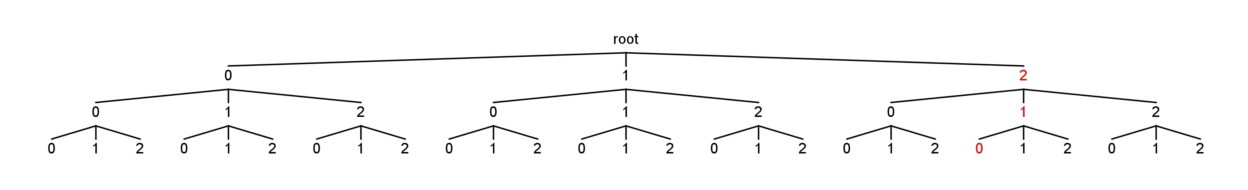
Reading Forward (right-to-left)
012

Slide 12
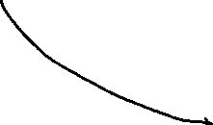
Reversing The Read Order
index (i) | i = 3 | i = 2 | i = 1
value | x₃ × 3² | x₂ × 3¹ | x₁ × 3⁰
gene | gene 3 | gene 2 | gene 1
index (i) | i = 3 | i = 2 | i = 1
value | x₃ × 3² | x₂ × 3¹ | x₁ × 3⁰
gene | gene 1 | gene 2 | gene 3

Slide 13
Reading Backwards (left-to-right)
000

Slide 14
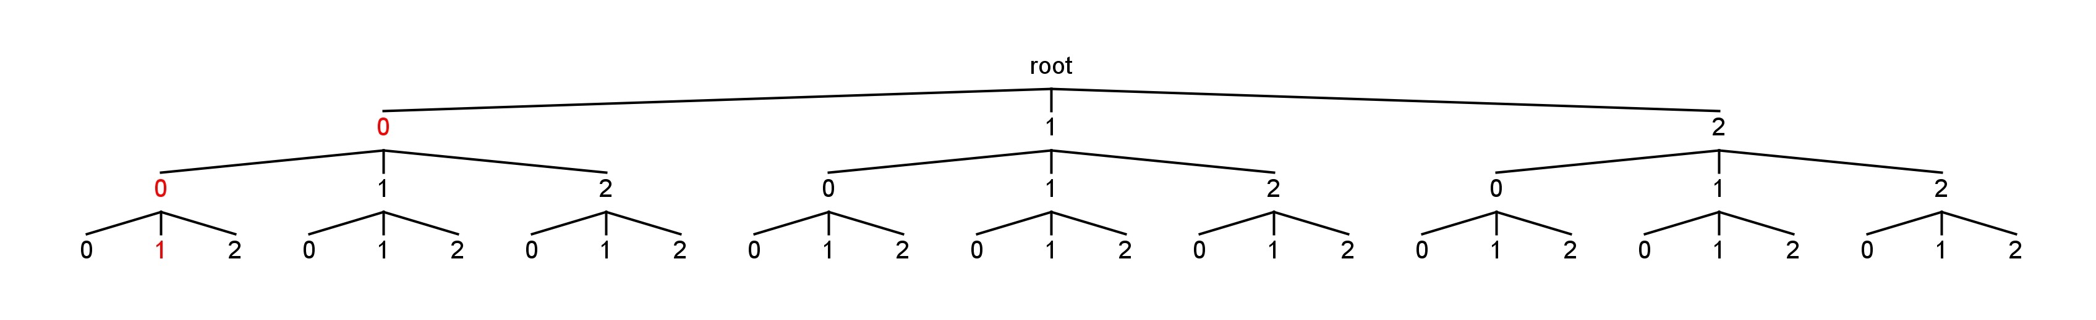
Reading Backwards (left-to-right)
001

Slide 15

Reading Backwards (left-to-right)
002

Slide 16
Reading Backwards (left-to-right)
010

Slide 17
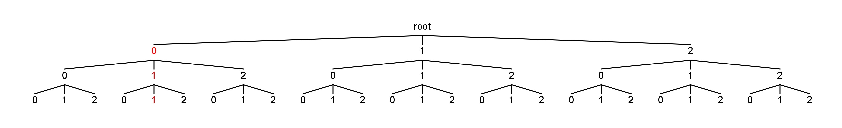
Reading Backwards (left-to-right)
011

Slide 18
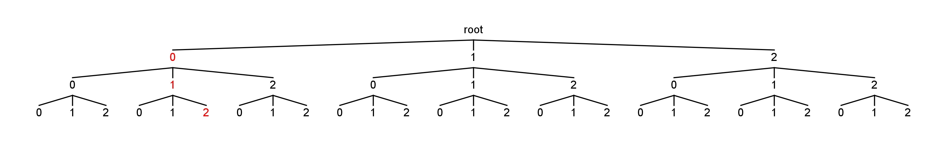
Reading Backwards (left-to-right)
012

Slide 19
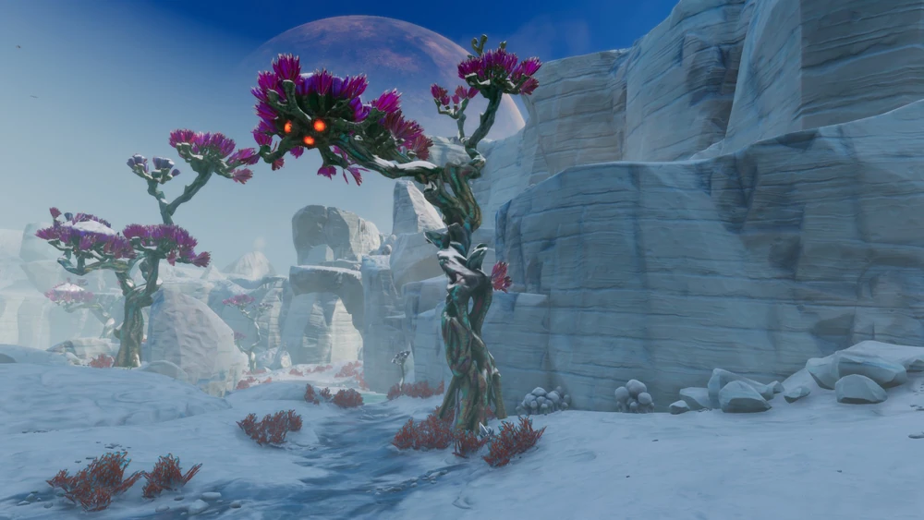
Reading Backwards (left-to-right)
This will make sense later, I promise.

Slide 20
Brute Force
The naïve brute-force method is to solve all possible enumerated states
Combinatorial explosion
There are n³ possible enumerated combinations

Slide 21
Applying Branch and Bound
We don’t want to evaluate all possible solutions. So we need to prune based on an upper bound.
How do we find the relaxation (or upper-bound) for this maximization problem?
Solution: Find the percentage of ups (+1), and also of downs (-1), of the case patients for each gene.

Slide 22
Applying Branch and Bound
Relaxation solutions for example data set
Store the solutions in one “up” array and one “down” array
 | Case 1 | Case 2 | Case 3
G1 | 1 | 0 | 0
G2 | 0 | -1 | 0
G3 | 1 | 1 | -1
 | “Up” relaxed solution | “Down” relaxed solution
G1 | 0.33 | 0.00
G2 | 0.00 | 0.33
G3 | 0.66 | 0.33

Slide 23
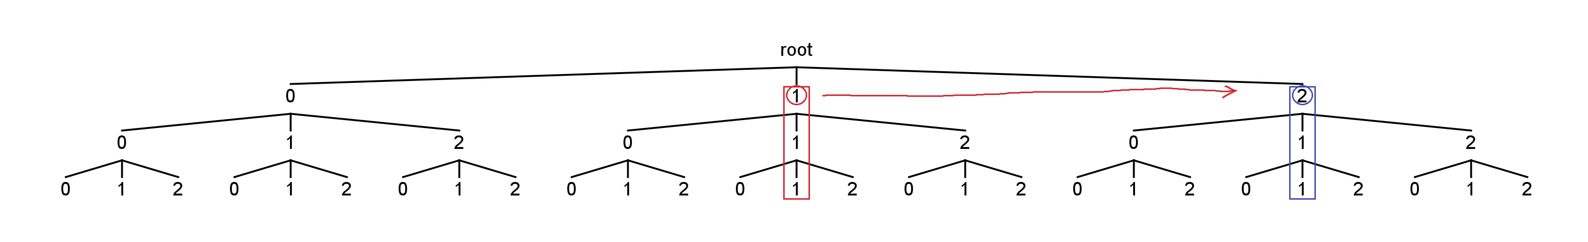
Applying Branch and Bound
Before we solve for the solution, we read the counter left-to-right.
Because the “1” in the first position represents “up” we compare the incumbent solution with the relaxed “up” solution for that gene.
If the relaxed solution is better than the incumbent, increment the counter at that position.
111→ 211

Slide 24
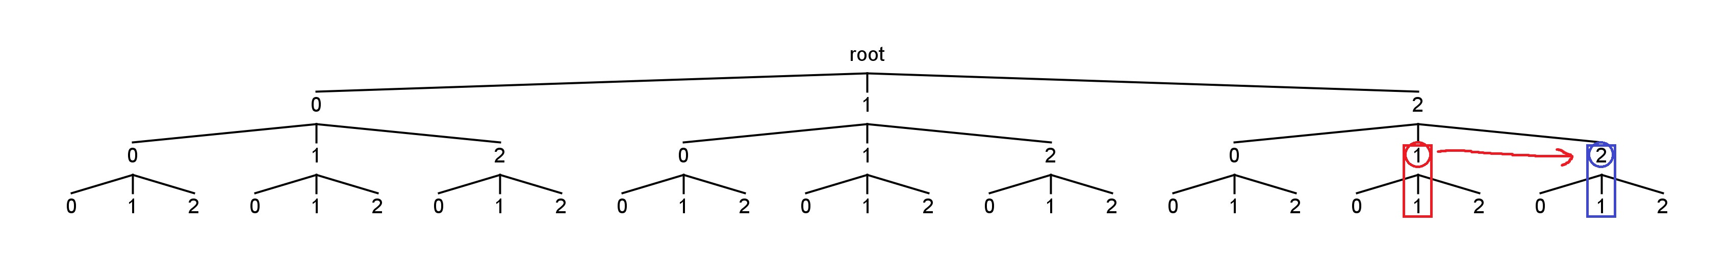
Applying Branch and Bound
Continue reading the counter
Relaxation is better than incumbent again, so increment again
211→ 221

Slide 25
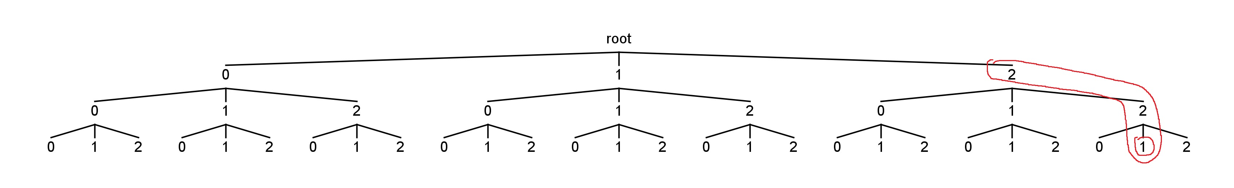
Applying Branch and Bound
Suppose the relaxation here is not better.
Loop the comparison to relaxation arrays again in case a higher order “bit” has flipped. (Won’t go into this too much here.)
If no changes, then solve associated solution at: 221.
Increment the counter and then reapply the comparisons

Slide 26
Results: Synthetic Set 1
Process took 0 seconds
Expression Pattern:
G11 Low
G16 High
Cases with Pattern:
D4 D5 D9 D10
Controls with Pattern:
J = 0.4

Slide 27
Results: Synthetic Set 2
Process took 0 seconds
Expression Pattern:
G3 Low
G20 Low
Cases with Pattern:
D1 D2 D3 D4 D6 D7 D8 D9 D10
Controls with Pattern:
C1 C2
J = 0.7

Slide 28
Results: Synthetic Set 3
Process took 0 seconds
Expression Pattern:
G8 High
G17 Low
G18 Low
Cases with Pattern:
D1 D2 D3 D4 D6 D8 D9 D10
Controls with Pattern:
C2 C5 C8
J = 0.5

Slide 29
Results: Synthetic Set 4
Process took 0 seconds
Expression Pattern:
G1 Low
Cases with Pattern:
D5 D6 D7 D8 D10
Controls with Pattern:
J = 0.5

Slide 30
Results: Biological Data Set
Data set is from:
The genomic architecture of sickle cell disease in children from West Africa
Data set contains 47,323 genes (rows)
250 patients
31 controls

Slide 31
Results: Biological Data Set
Since 3³³ = 5.59 quadrillion
The age of the universe is around 437 quadrillion seconds
It is not likely I can solve a problem with 3⁴⁷³²³ combinations
My 100 gene data set also timed out after 2 days.

Slide 32
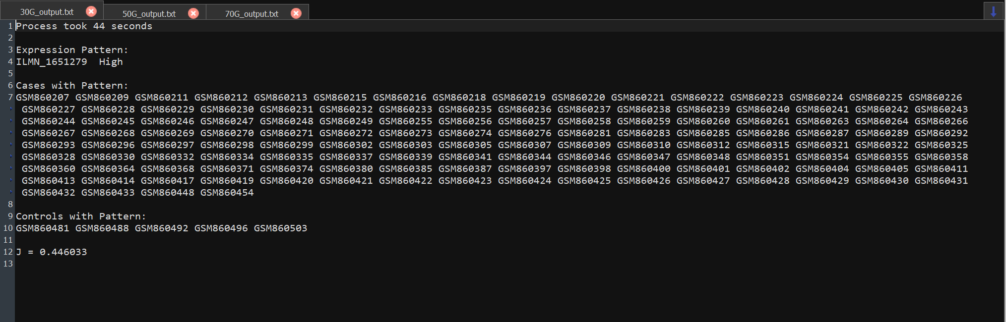
Results: Biological Data Set
44 seconds

Slide 33
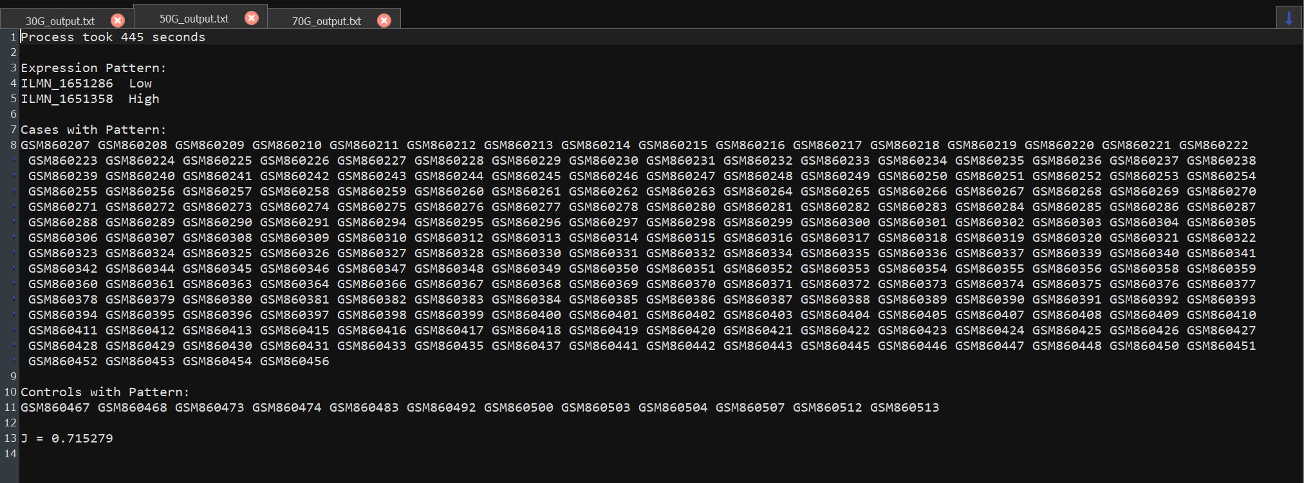
Results: Biological Data Set
7 minutes and 25 seconds

Slide 34
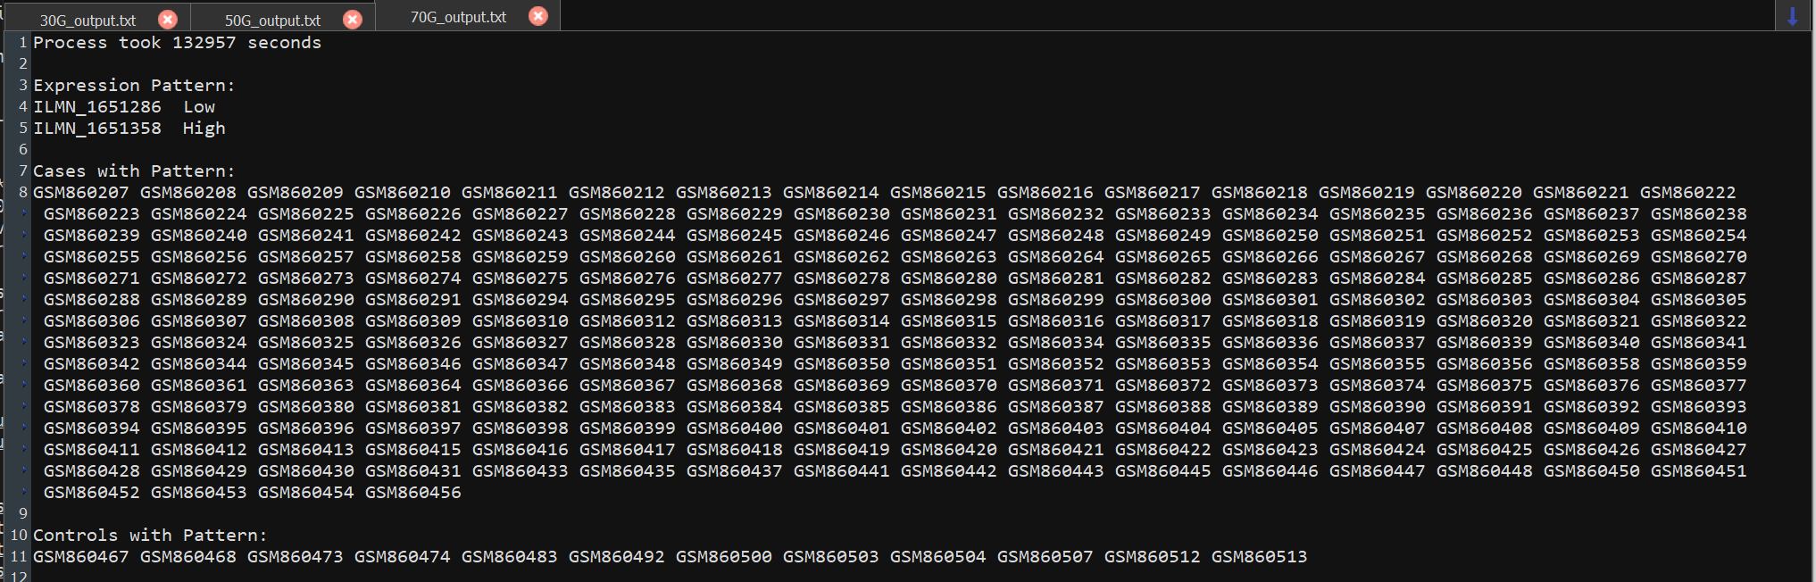
Results: Biological Data Set
Around ~37 hours

Slide 35
Size of Data Set | Time for Optimal Solution
30 genes | 44 seconds
50 genes | 445 seconds
70 genes | 132,957 seconds
Size of Data Set | Time for Optimal Solution
20 gene (synthetic data) | <1 seconds
30 genes | 44 seconds
50 genes | 445 seconds
70 genes | 132,957 seconds

Slide 36
Index (i) | i = 3 | i =2 | i = 1

Slide 37
Index | i = 3 | i = 2 | i = 1
Base-10 conversion | x₃ × 3² | x₂ × 3¹ | x₁ × 3⁰
Gene | Gene1 | Gene 2 | Gene 3

